Slide 1
Online Tutoring System for Android LearnAble!
Final Year Project
Final Report (2011-2012)
Tai Ching Kiu Wong Ho Fung Fung Ka Yiu
Software Engineering Student

Slide 2

Project Objective
Develop an Online Tutoring System
Make distance learning easier and effective
Student able to give respond during the lesson
Give opportunity to join class activity to share ideas

Slide 3
Problem Background
The distance is long from school sometime
Time use in transportation is long and some many time wasted
Extra instruction from teachers of other nation
Online tutoring system could help with situation above

Slide 4


Function Provided
Voice Walkie-Talkie
Support one-to-one voice chat with walkie-talkie style
Able chat with user during the lesson.
Group Chat / One Chat
Able to chat with other user(students and teachers) in same lesson
Able to chat to all user in same lesson at the same time and one user only
Uses XMPP make the function multi-platform

Slide 5
Function Provided
Asking Question
Student able to ask question during the lesson
Other student can give a “like” if they have similar question
Teacher will answer the question verbally during the lesson
Lesson Video Streaming
Streaming the whole lesson by capture teacher face
Student can attend lesson everywhere whit quality network
Lesson can be archived and watch afterwards

Slide 6
Function Provided
PowerPoint Presentation Synchronization
Allows teachers showing PowerPoint to students’ device the same page
System process the PowerPoint file and change to static picture
White Board
Allows teacher drawing on the board student able to see the drawing at the same time
Transform to command and transfer through XMPP

Slide 7
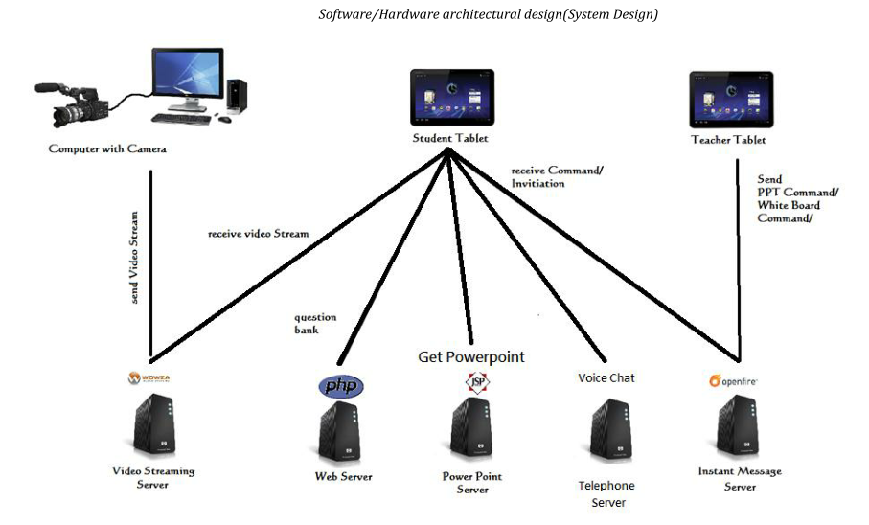
Make it simple~ 5 Servers 1 Service

Slide 8
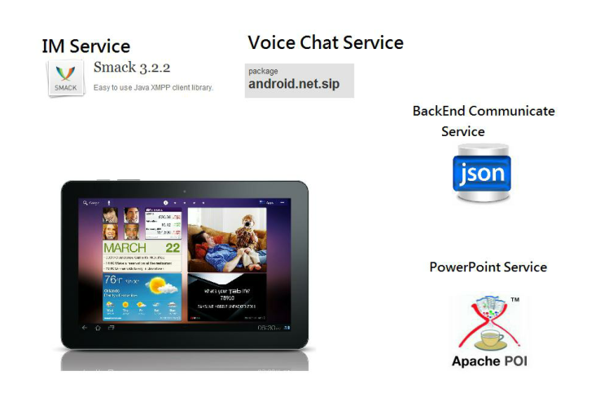
Thank you Open Source Contribute

Slide 9
High-Level Analysis
Layers in Whiteboard
Synchronization By using JSON

Slide 10

Layers in Whiteboard
Preview
/corner box
Object layer
( can change)
Draw layer
(can erase)
eraser
Background

Slide 11


Synchronization By using JSON
Message string
students
Message
string
teacher
Type of Message string : tag + JSON string
JSON type | Detail | Example
Touch Event (x, y coordinate ) | the action is decided by current control | Touch up / move / down
Change Control | To change the current control | Draw Circle Control
Change Setting | Change color , thickness , draw in background , border only
Action | To redo , undo , change order ,change layer | Move to front , bottom
Page Change | Change page no.
Whiteboard
PPT

Slide 12
Design Diagram

Slide 13
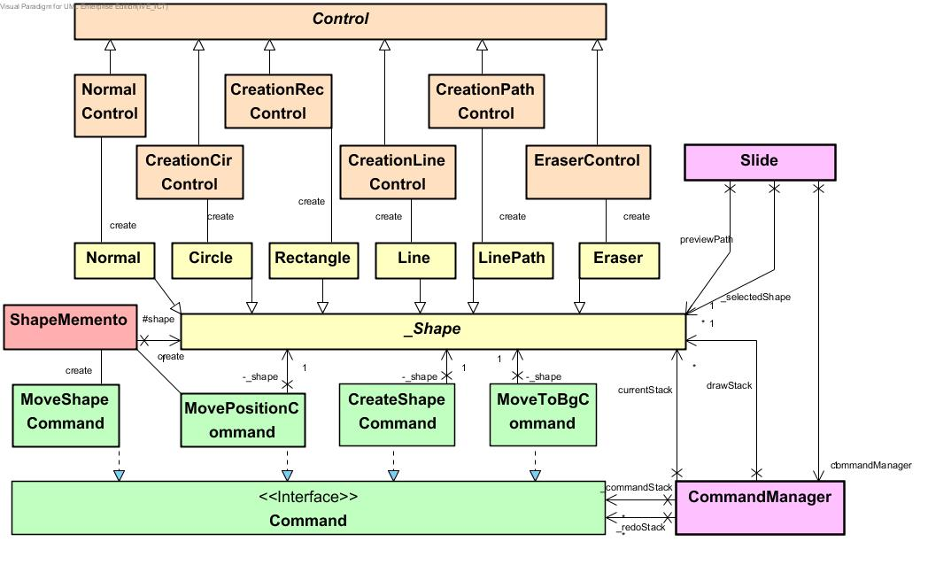
Whiteboard – Class Diagram(simple ver.)

Slide 14
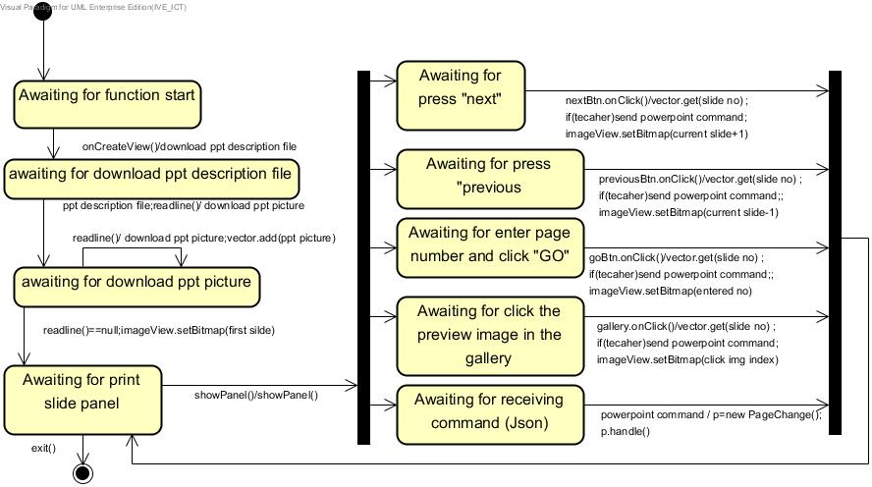
PowerPoint – android controller

Slide 15
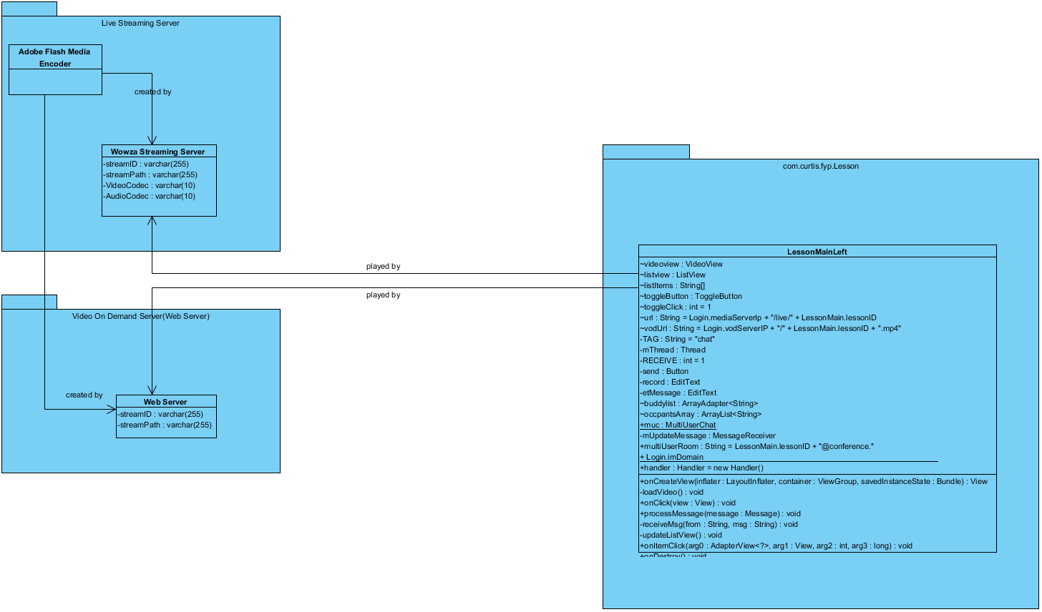
Video Streaming

Slide 16
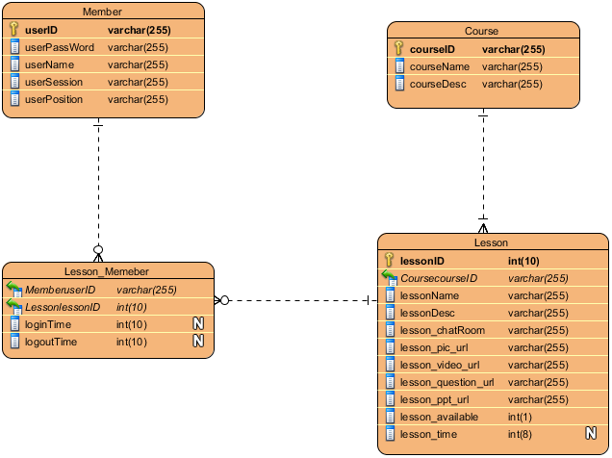
BackEnd

Slide 17
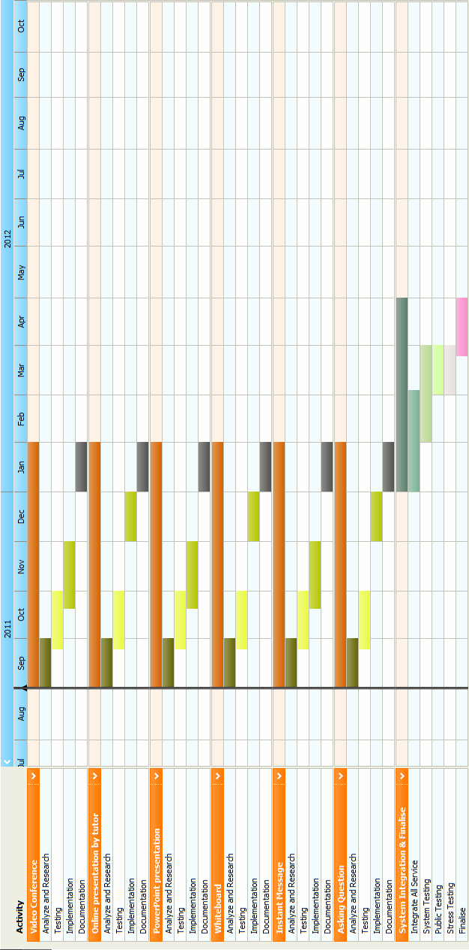
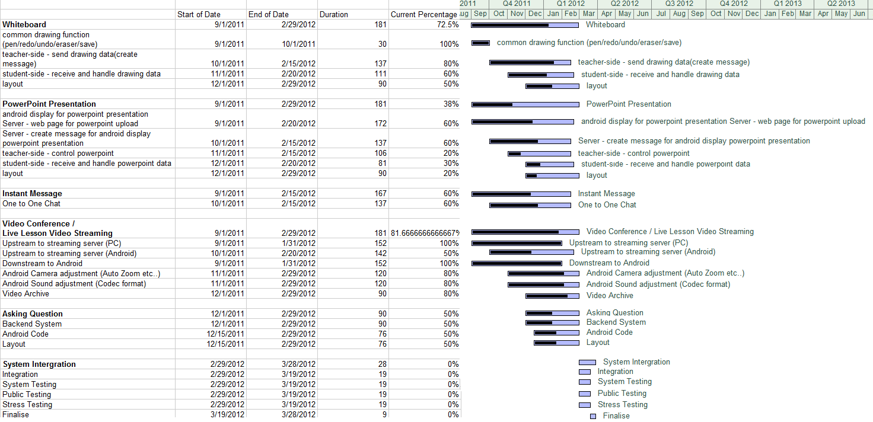
Planned and Actual Project Schedules

Slide 18
Testing Strategy
During the development
Use White-Box testing
Debug Line by line with logical or syntax error
Enter with different variable to the method to check if functions work appropriate
Operate by our team
Testing Stage
Use Black-Box testing
Invite classmate to test.
Test if any invalid output lead to error
But Still there may have some bugs we cant found. Please help us to find out together.

Slide 19
Final Outcome
PowerPoint
White Board
Group / One Message Chat
Live / Archive lesson Streaming
Ask Question

Slide 20
Critical Evaluation
We cant do…
White Board
Note Taking / Achieve Version / Capture
Due to tight time
Video Conference
Open source Library (C lang) not easy adapt to Android
Not essential for a big class
Reduce scope as Voice Chat ( One to One)

